Slide 1
Object Oriented Design

Slide 2
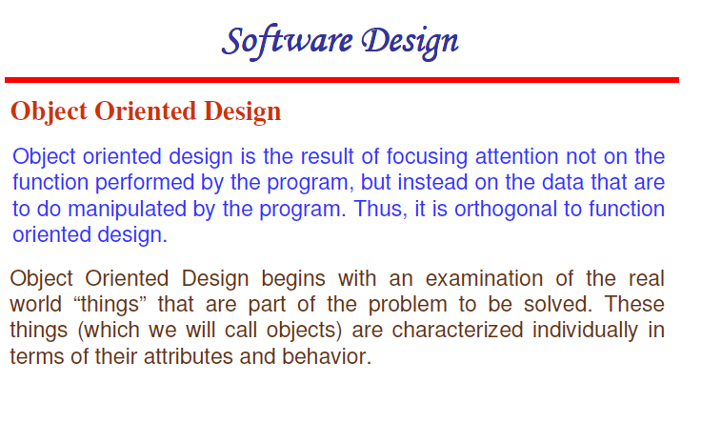

Slide 3
Difference between FOD & OOD
The design approach is fundamentally different from the function-oriented design approaches primarily due to the different abstraction that is used.
It requires a different way of thinking and partitioning.
It can be said that thinking in object-oriented terms is most important for producing truly object-oriented designs.

Slide 4
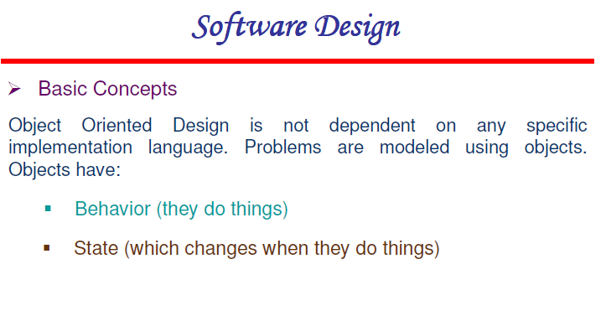

Slide 5
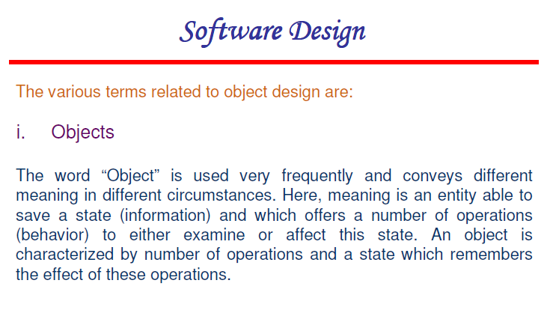

Slide 6
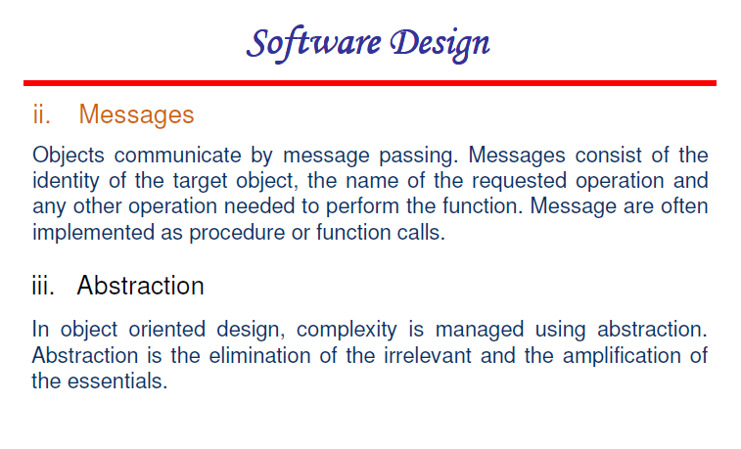

Slide 7
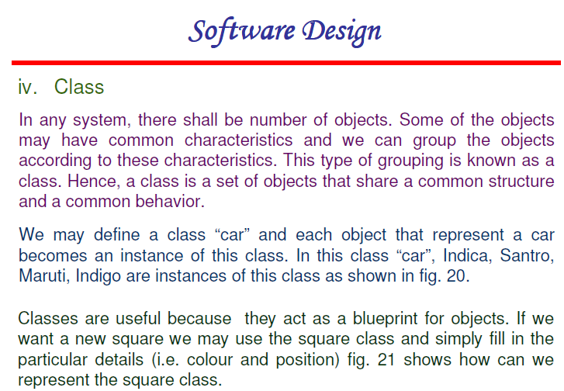

Slide 8
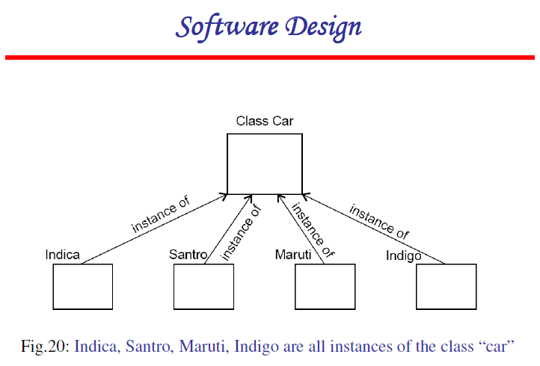

Slide 9
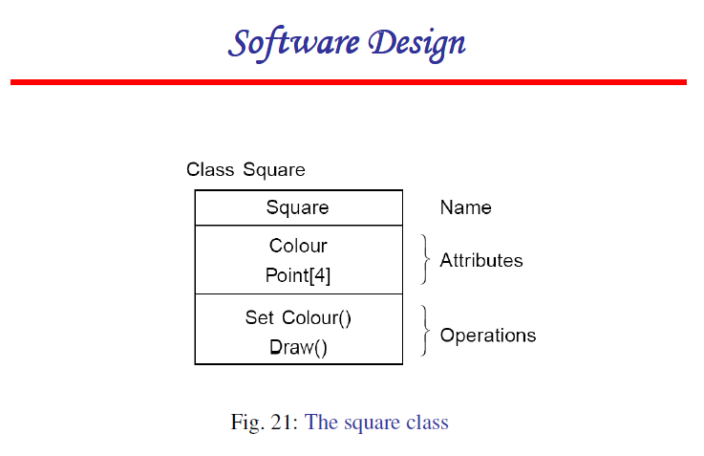

Slide 10
Operations in a class can be
Public: accessible from outside
Private: accessible only from within the class
Protected: accessible from within the class and from within subclasses

Slide 11
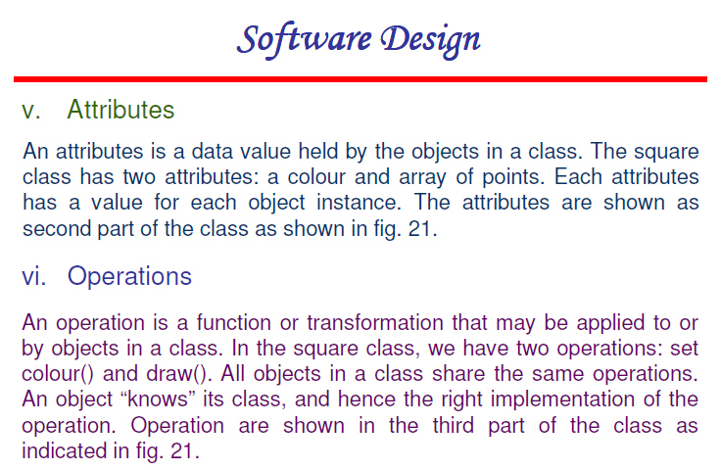

Slide 12
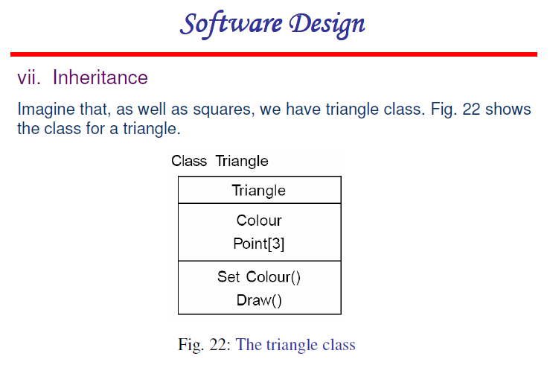

Slide 13
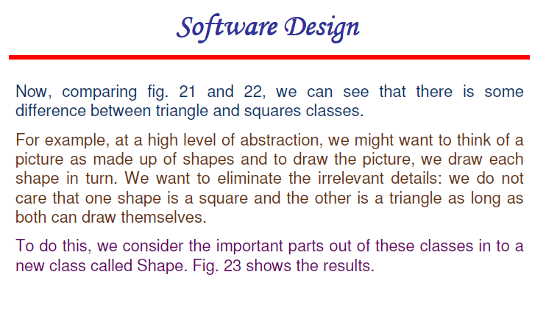

Slide 14
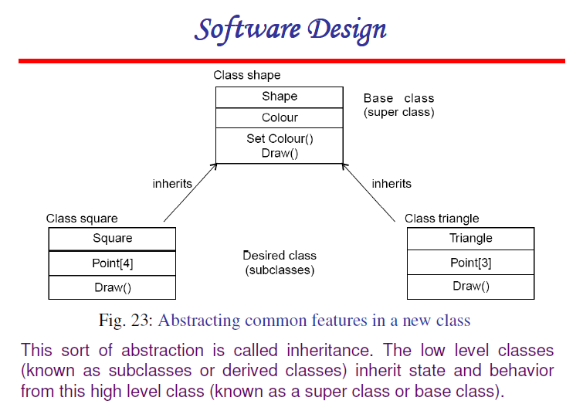

Slide 15
Single inheritance – a subclass inherits from only one superclass
Class hierarchy is a tree
Multiple inheritance – a class inherits from more than one class
Can cause runtime conflicts
Repeated inheritance - a class inherits from a class but from two separate paths

Slide 16
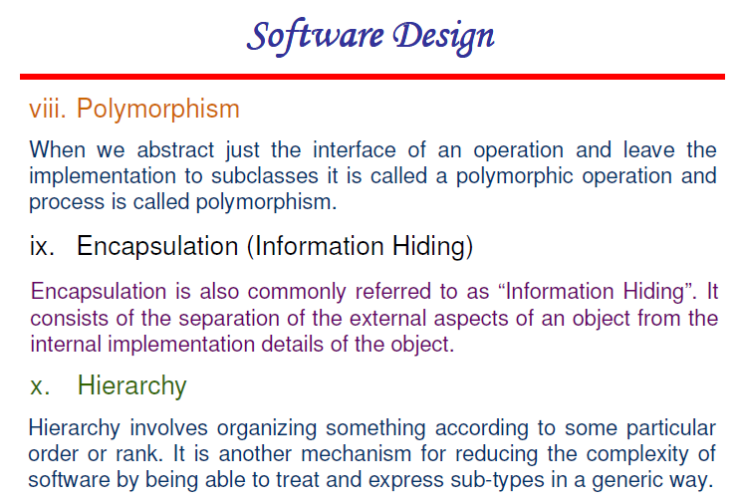

Slide 17
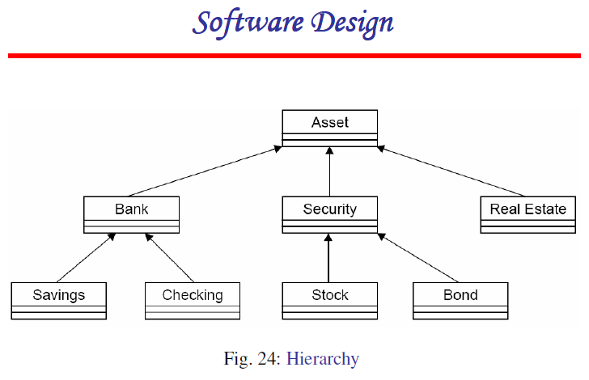

Slide 18
Unified Modeling Language (UML) and Modeling
UML is a graphical notation useful for OO analysis and design
Allows representing various aspects of the system
Various notations are used to build different models for the system
OOAD methodologies use UML to represent the models they create

Slide 19
Modeling
Modeling is used in many disciplines – architecture, aircraft building, …
A model is a simplification of reality
A good model includes those statements that have broad effect and omits minor statements
A model of a system is not the system!

Slide 20
Why build models?
Models help us visualize a system
Help specify the system structure
Gives us a template that can guide the construction
Document the decisions taken and their rationale

Slide 21
Views in an UML
A use case view
A design view
A process view
Implementation view
Deployment view
We will focus primarily on models for design – class diagram, interaction diagram, etc.

